Slide 1
Recommending a Strategy
Ideas for today and tomorrow

Slide 2
Vision Statement
State the vision and long term direction.

Slide 3
Abstract
State the desired goal.
State the desired objective.
Use multiple points if necessary.

Slide 4
Today’s Situation
Summary of the current situation.
Use brief bullets, discuss details verbally.

Slide 5
How Did We Get Here?
Any relevant historical information.
Original assumptions that are no longer valid.

Slide 6
References
https://engineering.linkedin.com/data/publications/kdd-2017/deep-learning-tutorial

Slide 7
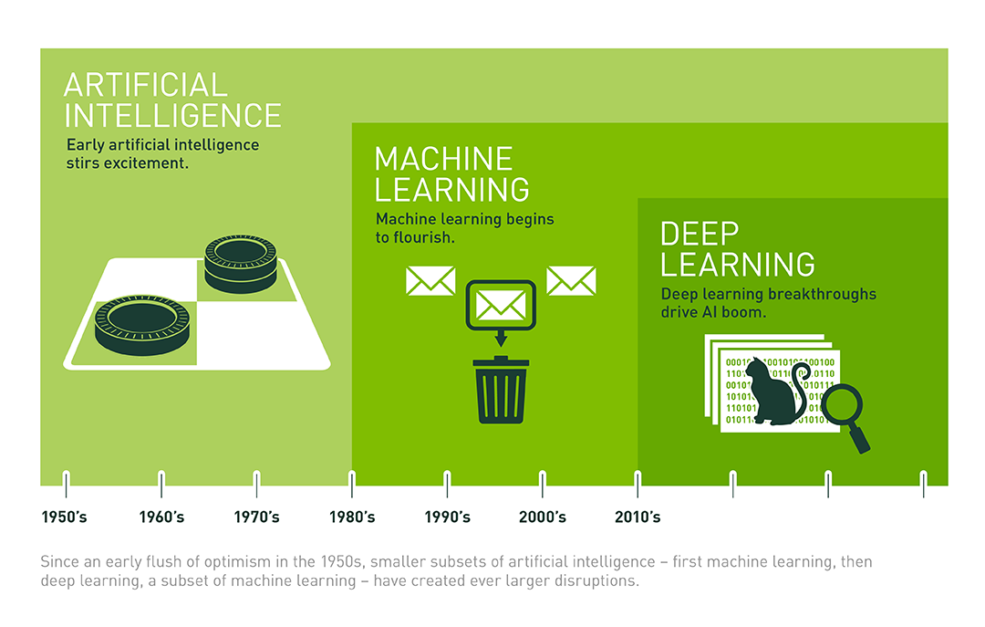
Why Deep?
Deep Learning is a field of Machine Learning that allows computational models that are composed of multiple processing layers of representation and abstraction that help to make sense of data such as images, sound, and text.
https://medium.com/@libreai/a-glimpse-into-deep-learning-for-recommender-systems-d66ae0681775

